Slide 1


Slide 2
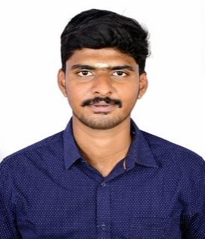
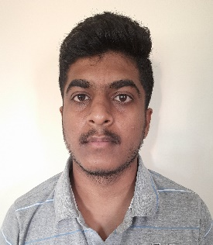
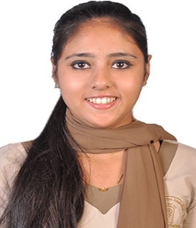
Project Highlights
Project Name : D News
Team Size : 3
BU Mentor Name : Mentor PS#
Team Members Details
TS Visvak Kumar
PS:99002785
2010MYSSPY02
BE Computer Science
Skills:-Python , Android, Node Js, Web Development
Binduja S
99002756
2010MYSSPY02
BTech IT
Skills :- Spring, Android, Web Development
Divya P
990027
2010MYSSPY02
Education Details
Skills :- JAVA, C++ , Web development.

Slide 3
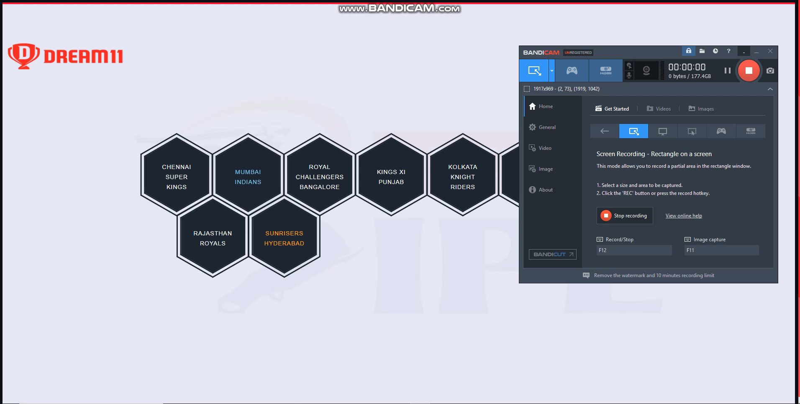
Project Video Snippet

Slide 4
Future development that can be implemented further
Login Authentication for users to maintain data security
Enabling live broadcast of match.
Database storage of live chats so that they can access it later.
Providing a platform for venturing players.

Slide 5


Thank You !

